Slide 1
Chest Build Procedure

Slide 2
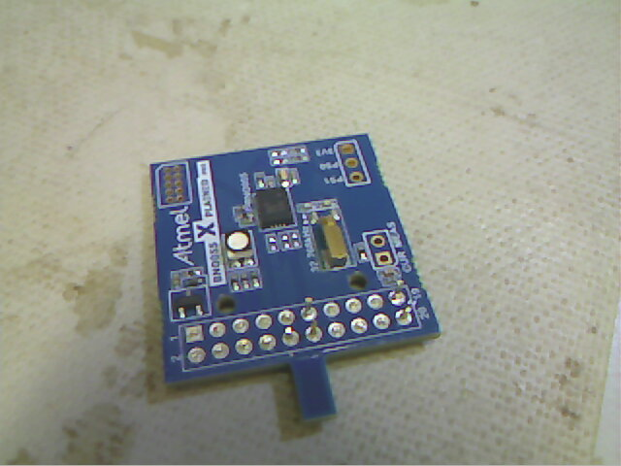
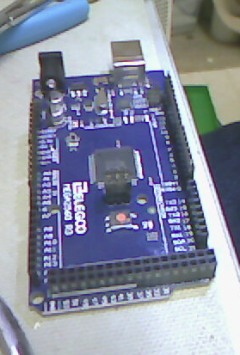
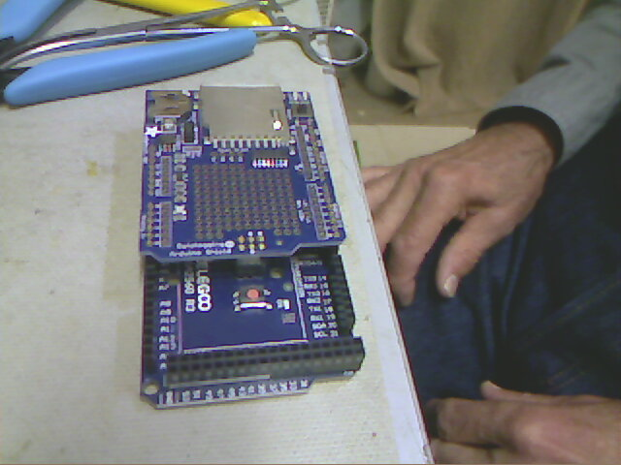
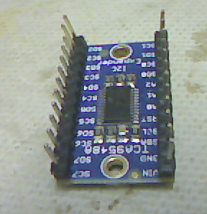
Names of Boards refer to this page to get the names of the components.
IMU (inertial measurement Unit)
Mega 2560 (the brain)
Adafruitt Data Logging Shield (SD card board)
Adafruit I2C multiplexer board.

Slide 3
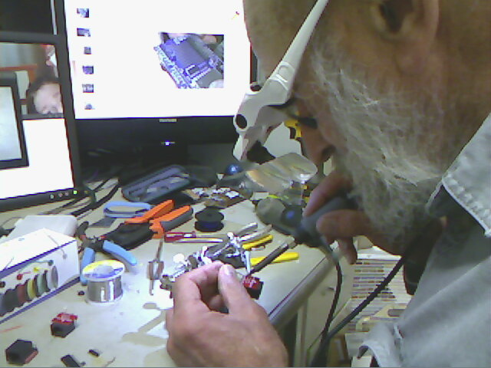
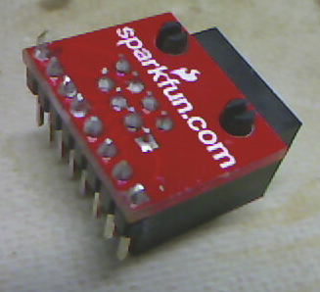
During build make sure all solder joints connect the pin to the hole (no gold rings showing). Hold the iron for a second or two on the pin to let the solder wick into the shaft with the pin in it)

Slide 4
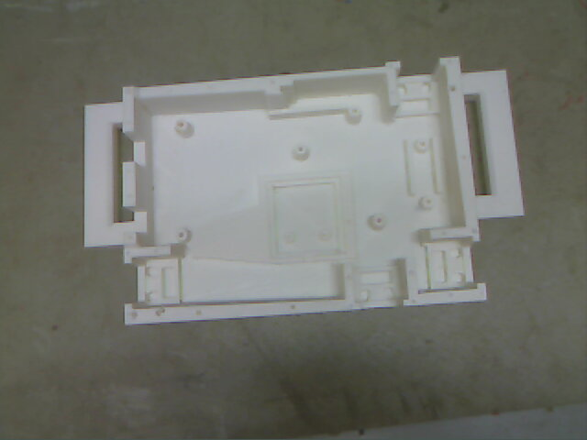
Print Out Chest Base

Slide 5
Install all headers necessary to solder to the Adafruit Data Logging (sd card) shield into the Mega 2560 board.
Don’t forget the female header on the center pins.

Slide 6
Add the shield on to the 2560 and solder all of the headers in.

Slide 7
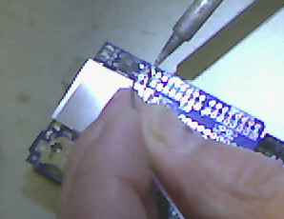
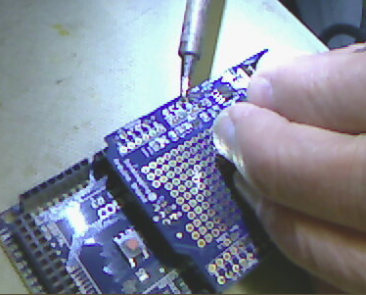
Make sure and fully solder the pins on all headers

Slide 8
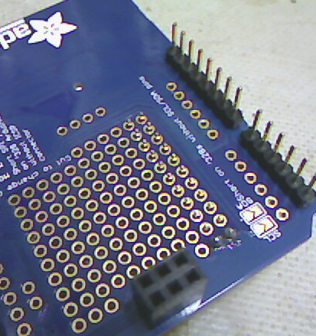
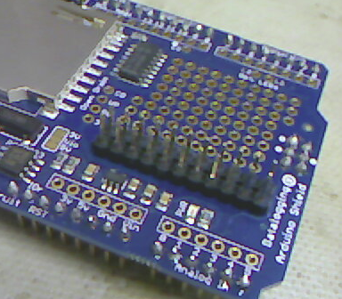
3.3v and ground header
(DO NOT USE 5V)
Install two rows of headers as shown. Tack them in at each end with solder

Slide 9
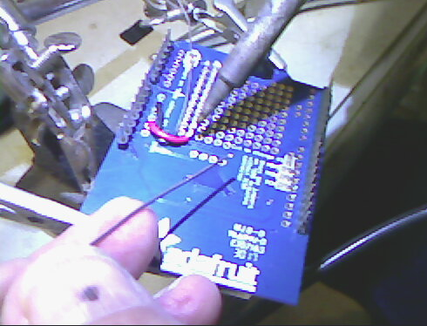
Solder a Red Wire up through the 3V hole and connect it to the row of header that is closest to the center of the board.

Slide 10
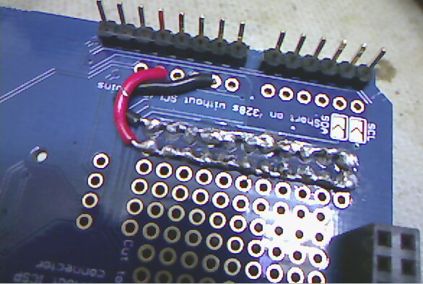
Connect a black wire through the Gnd hole and connect it to the row of pins closest to the edge

Slide 11
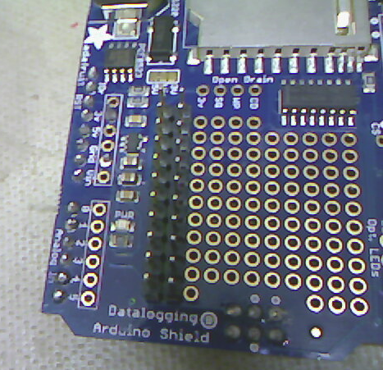
This is what the header looks like when done.

Slide 12
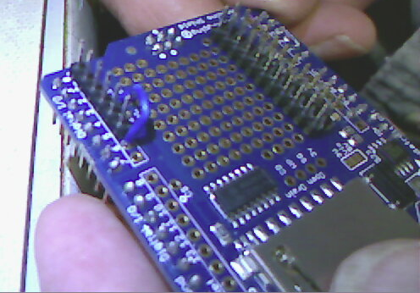
Solder a Header on pins 0-5 and
Solder a wire on the topside from L1 to pin 6 on the Data Logging shield

Slide 13
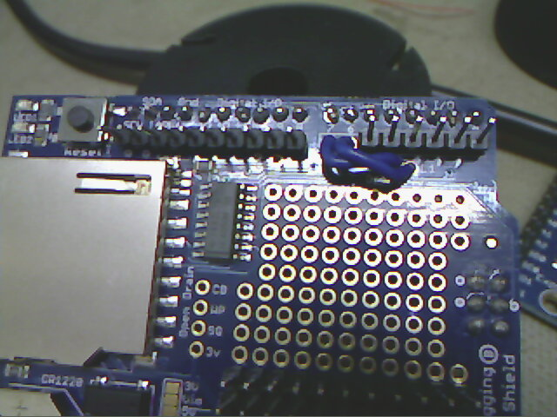
Put header on pins Sclk through 8 and Solder a wire on the topside from L2 to pin 7 on the Data Logging shield

Slide 14
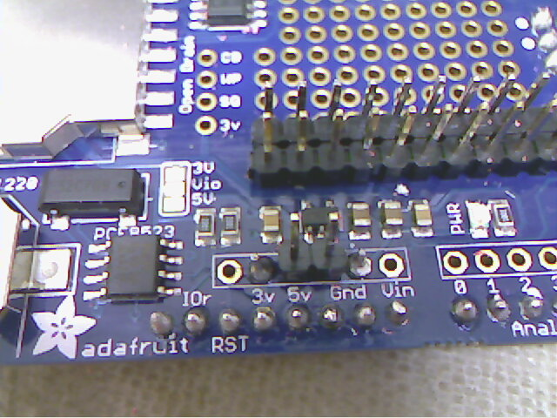
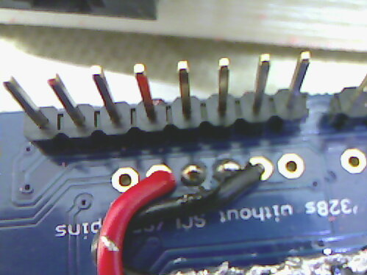
Install a 2 pin header on 5V and Ground as shown. Solder from the back side.

Slide 15
Clip all pins on the IMU flush except 11,12,19 and 20.

Slide 16
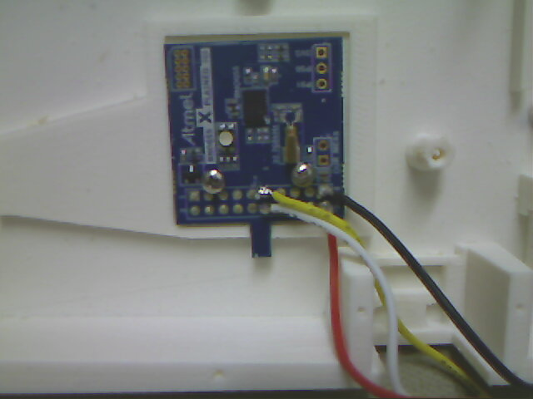
Solder four stranded wires 4-5 inches long: red-20,black-19,white-12,yellow 11.

Slide 17
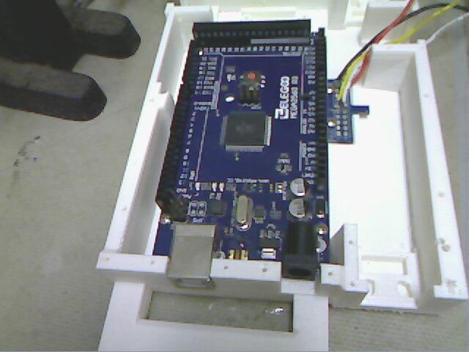
Install Arduino Mega 2560

Slide 18
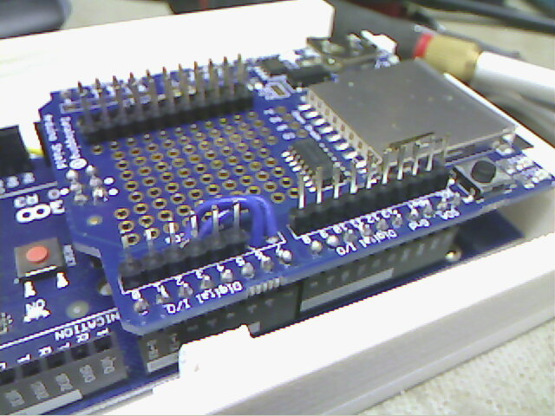
Install Data Logging Shield on to Mega 2560 (line up male females as shown)

Slide 19
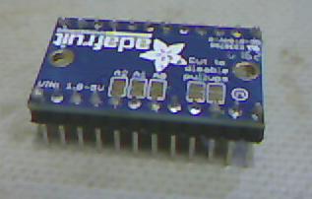
Solder in vertical headers on i2c multiplexer.

Slide 20
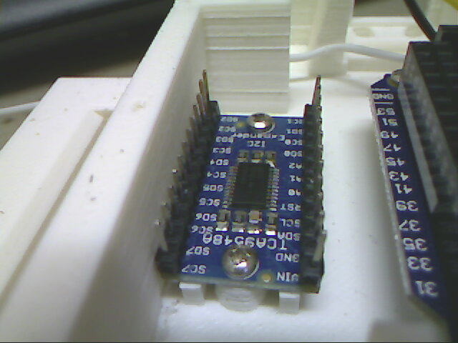
Install I2C Multiplexer into assembly as shown (note orientation).

Slide 21
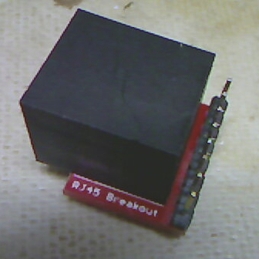
Make four Ethernets with headers on them as shown

Slide 22
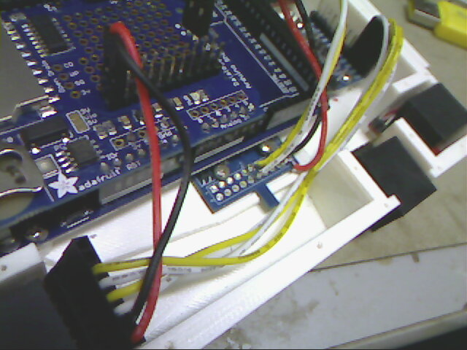
Epoxy the four Ethernets into their locations in the assembly
Start a Harness On the Upper Left Arm Connector. Create two wires for power and four wires for SDA and SCLK.

Slide 23
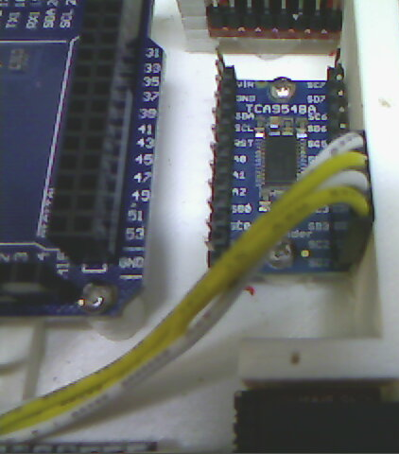
Finish the Upper Left Harness by connecting it to SD2, SC2, SD3, and SC3 as shown
Pin 3 white of the Ethernet goes to SC2,
Pin 4 yellow goes to SD2,
Pin 5 white goes to SC3 and
pin 6 yellow goes to SD3.

Slide 24
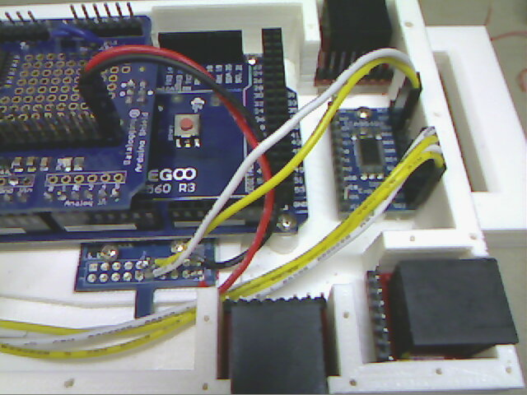
Put two two pin terminals on the wires coming off of the IMU that we put in previously.
Red always goes on
the center rail.
Connect the wires as shown. Red and black go to Power and Gnd as shown.
12 white goes to SD6 and
11 Yellow goes to SC6.

Slide 25
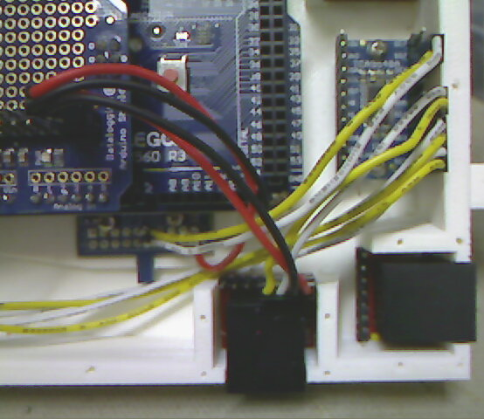
Create the head harness
Create a four pin header that connects to the head ethernet as shown. Pins 1(power) and 2(gnd) go to the power header on the data logging shield. Pin 3 white goes to SC4 and Pin 4 yellow goes to SD4. (as shown

Slide 26
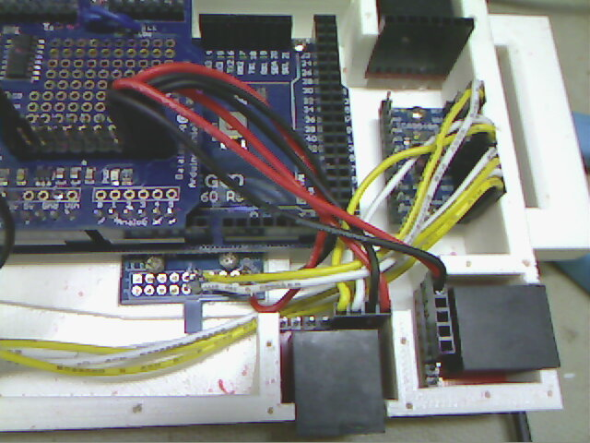
Wire up the Right Arm. Put a Red on Pin 1 and Black on Pin 2. Place a two pin header on them and connect them to the power rail header on the data logging shield.

Slide 27
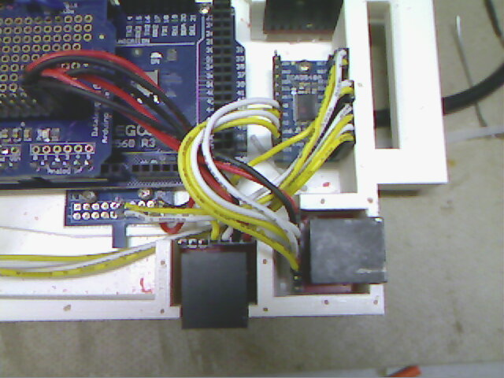
Pin 3 White goes to SC0.
Pin 4 Yellow goes to SD0
Pin 5 White goes to SC1
Pin 6 Yellow goes to SD1

Slide 28
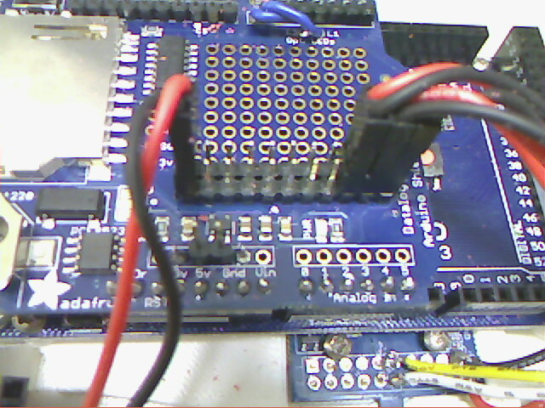
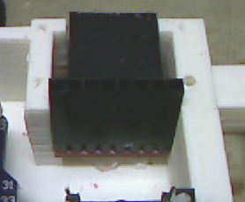
Create a harness for the waist.
Pin1 Red goes to 3.3v header.
Pin2 Black goes to 3.3v ground header
Pin 7 Red goes to 5v on two pin 5V Gnd header
Pin 8 Black goes to Gnd on two pin 5V Gnd Header
Pin 1
Pin 8
3.3v gnd header
5V Gnd header

Slide 29
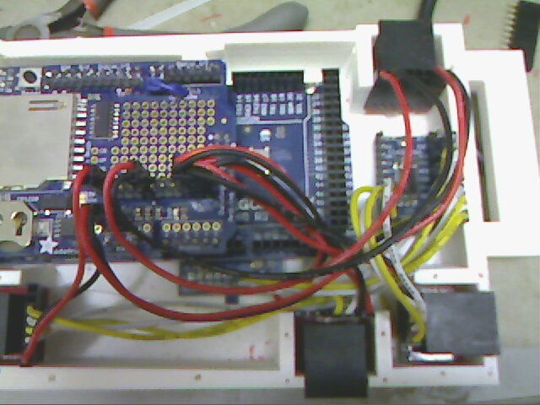
Wire the waist power as shown.

Slide 30
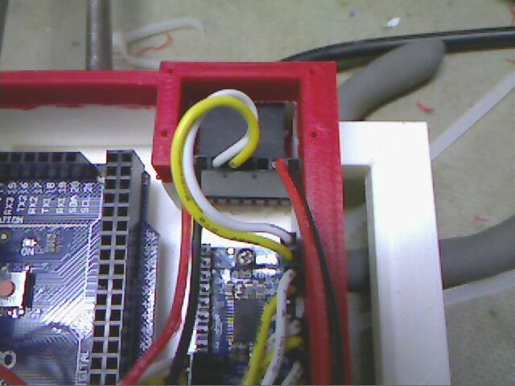
Install two wires On the waist connector.
Pin 3 White goes to SC7
Pin 4 Yellow goes to SD7

Slide 31
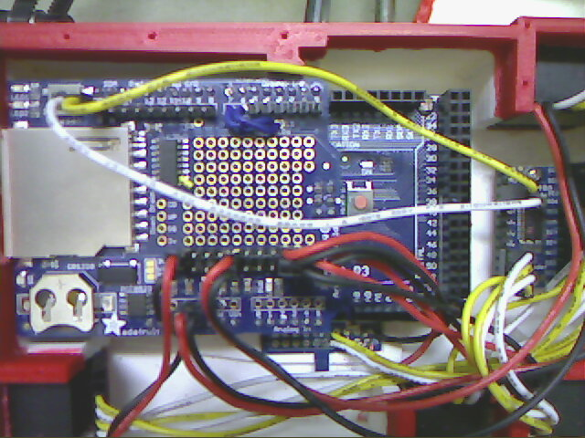
Create a two pin to two pin harness with one white wire and one yellow wire.
SDA – white from the Data logging shield goes to SDA white on the I2c Multiplexer.
SCL – Yellow from the data logging shield goes to SCL yellow on the i2c muliplexer

Slide 32
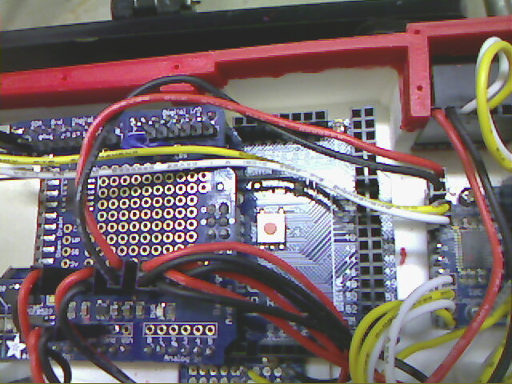
Create a 2 pin harness to power the I2C muliplexer.
Red Wire Vin from the I2C muliplexer goes to the 3.3V common header on the Data logging Shield.
Black Wire Ground should go from Gnd on the I2C muliplexer to the ground common header on the Data Logging Shield.

Slide 33
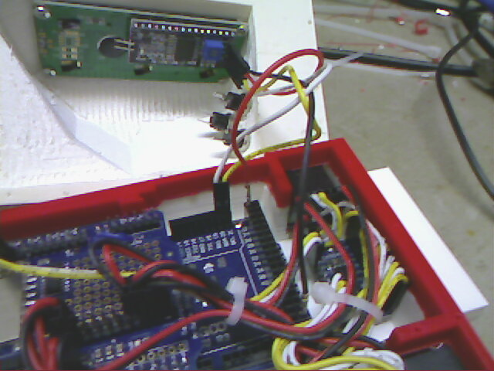
The LCD display in the lid has a 4 pin male header. Create four wires, with a male and female contact at each end:
Pin 1 of LCD GND: Female contact Black wire goes to male contact marked GND on header on Mega 2560 (see below)
Pin 2 of LCD VCC: Female contact Red Wire goes to male contact marked 5V on header on Mega2560 (see below)
Pin 3 of LCD SDA: Female contact Yellow wire goes to pin 20 marked SDA
Pin 4 of LCD SCL: female contact white wire goes to pin 21 marked SCL on the mega 2560. Male Contacts Pin 3 and 4 can go into a two pin housing to connect.

Slide 34
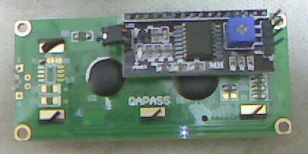
Setup LCD
Bend up the Pins on the LCD.
Make sure jumper is installed to enable backlight on LCD
After first Power Up you will need to adjust pot with phillips screwdriver to see anything on the display
Bend up
Jumper
Adjust POT

Slide 35
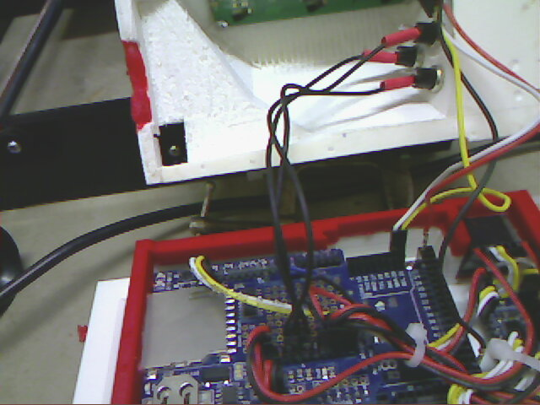
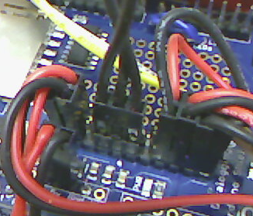
Make three black wires and solder each to a side of each of the switches. Take the other end to a 3 pin housing and connect it to the ground side of the 3.3V common power header (as shown)

Slide 36
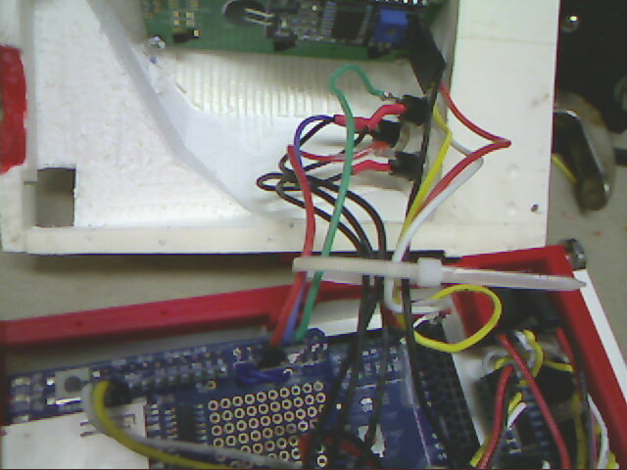
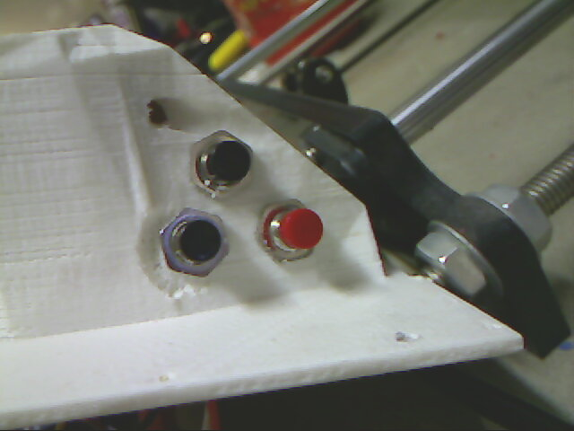
Make another 3 pin female house and connect with the following.
Red Wire goes to red switch and goes to pin 5 on the data logging shield.
Blue wire goes to bottom switch in photo and goes to pin 6 of the data logging shield.
Green Wire goes to top black switch in photo and goes to Pin 7 of the data logging shield.

Slide 37
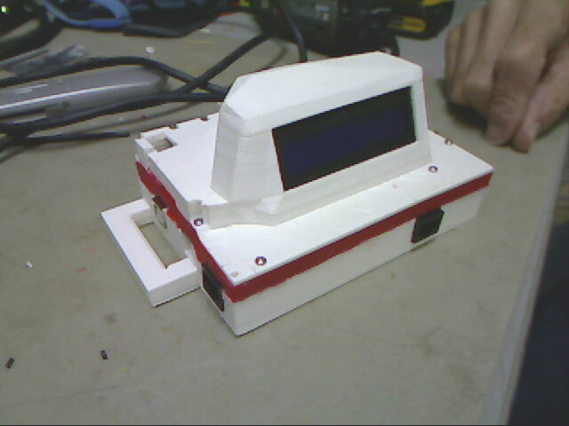
It‘s done!!!

